Slide 1


Development of a Biomimetic Spiking Neural Network Model for Multidimensional Tactile Perception
Team meeting Jaehun Kim
2023. 06. 09

Slide 2
Agenda
Progress updates
Tactile information processing Spiking Neural Network 고도화 및 평가(In progress)
센서 (DIGIT Tactile sensor X 2)및 로봇(UR3 + Robotiq gripper)기반 Online SNN 구축(In progress)

Slide 3



Result
Pressure
각기 다른 강도의 동일위치 자극물을 통해 압력정보를 성공적으로 디코딩할 수 있는지 테스트하였음.
출력 뉴런의 발화 강도를 통해 촉각 센서에 가해진 압력의 강도를 성공적으로 분류함.
Horizontal sustained pressure – High pressure
Horizontal sustained pressure – Low pressure
Horizontal stimulation
Horizontal stimulation
강한 자극
약한 자극
Pyramidal neurons firing pattern/ 2-D firing rate
Pyramidal neurons firing pattern/ 2-D firing rate
100
100
20
20
Neuron index
Neuron index
10
10
0
0
0
0
0
500
1000
0
500
1000
Time (ms)
Time (ms)

Slide 4
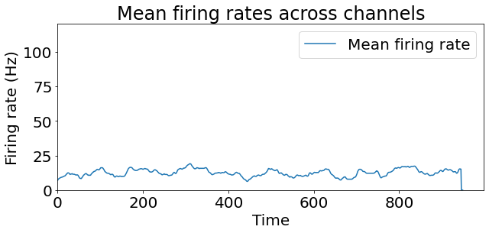
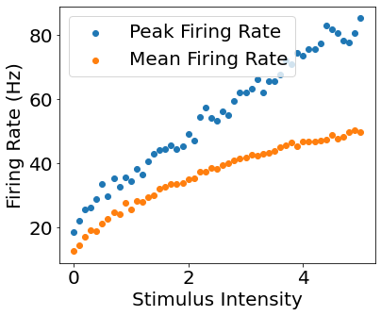
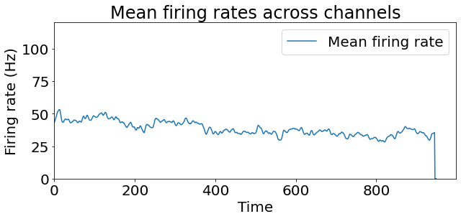
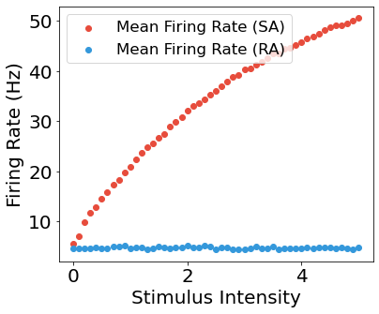
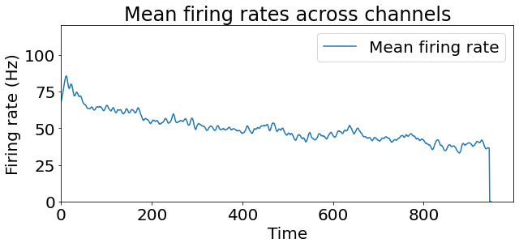
Result
Pressure
F = 0
F = 2.5
F = 5

Slide 5
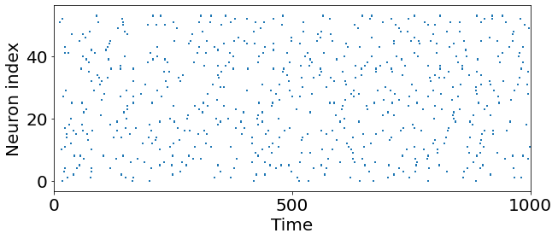
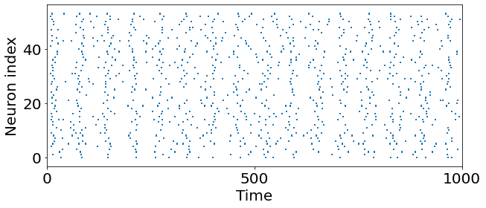
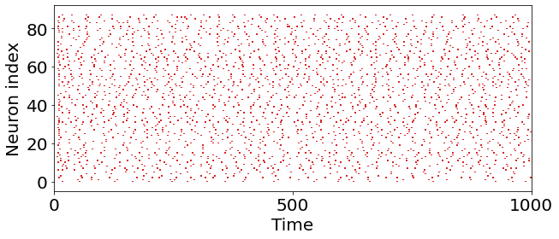
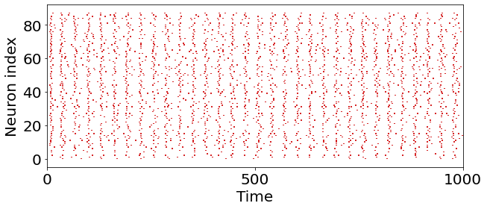
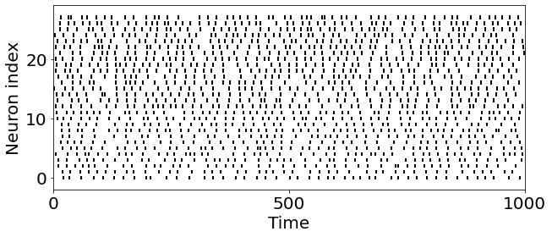
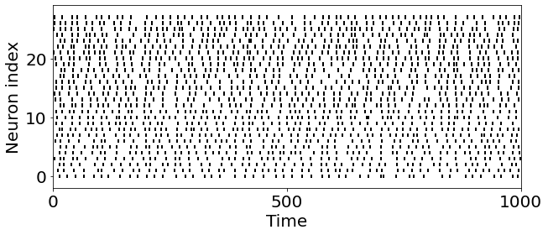
Result
Frequency
High frequency (150 Hz)
Low frequency (15 Hz)
SA - 1
SA - 1
RA - 1
RA - 1
PN
PN

Slide 6
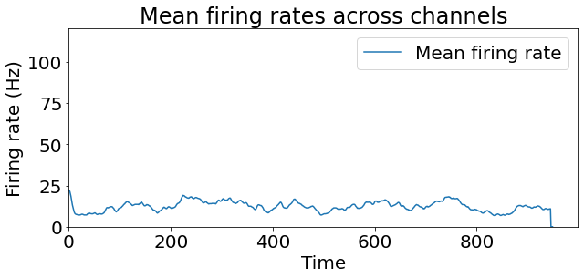
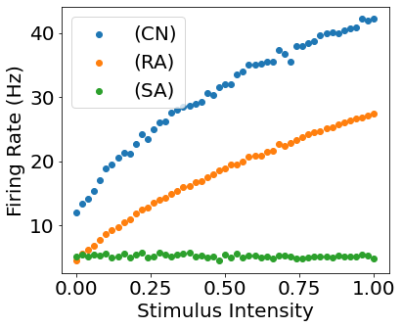
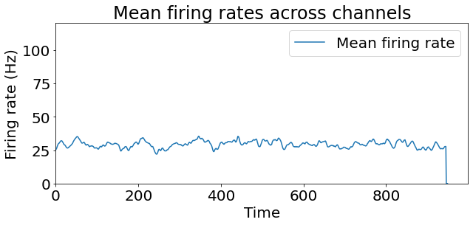
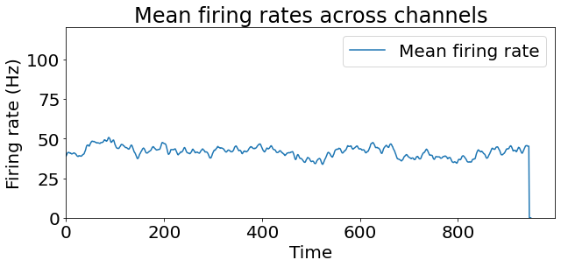
Result
Frequency
f =
F = 2.5
F = 5
Output layer 의 firing rate를 통해 Pressure와 frequency를 어떻게 구분해야 하나?

Slide 7
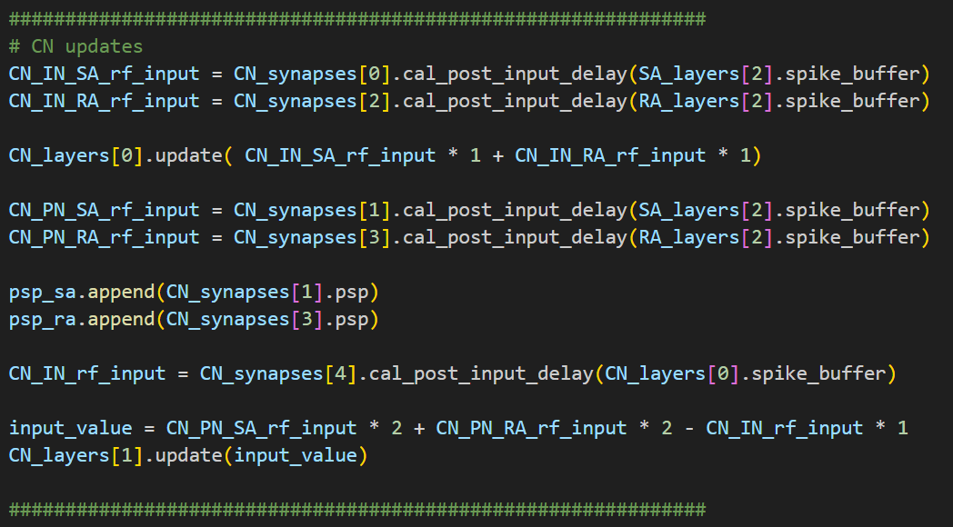
Method – 05.15
Synaptic weight
SA-1 Projection Neuron
Pyramidal neuron
RA-1
Projection Neuron

Slide 8
Result
Position
각기 다른 위치의 동일강도 자극물을 통해 위치정보를 성공적으로 디코딩할 수 있는지 테스트하였음.
출력 뉴런의 발화 강도를 통해 촉각 센서에 가해진 자극의 위치를 성공적으로 분류함.
Horizontal sustained pressure - Up
Horizontal sustained pressure - Down
Horizontal stimulation
Horizontal stimulation
Pyramidal neurons firing pattern/ 2-D firing rate (Hz)
Pyramidal neurons firing pattern/ 2-D firing rate (Hz)
100
100
20
20
Neuron index
Neuron index
10
10
0
0
0
0
0
500
1000
0
500
1000
Time (ms)
Time (ms)

Slide 9
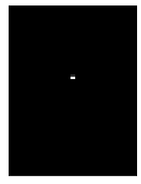
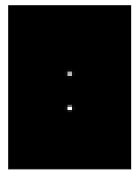
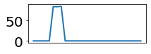


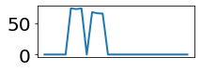

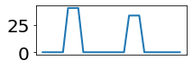

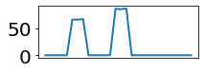
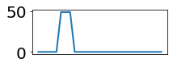

Result
Position – Two-point discrimination
Two-point discrimination test를 수행하여서, 해당 센서가 가진 공간 식별 정도를 테스트 하였음.
Result
Two-point stimulation
D = 0.1mm
- 두개의 dot stimulation의 distance(D)를 변화 시켜 가며 output layer의 신경 발화 패턴을 관찰
d1
d1 + d2
d1
D
D = 0.3mm
d2
d1
d1 + d2
d1
D1 + d2
D = 1.9mm
D가 충분히 멀 때
d1
d1 + d2
D가 가까울 때

Slide 10

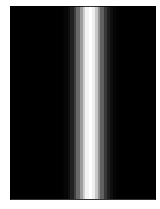
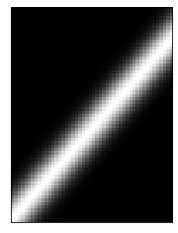
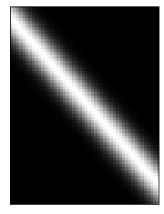
Result
Angle
각기 다른 orientation의 자극물을 통해 위치정보를 성공적으로 디코딩할 수 있는지 테스트함.
Horizontal stimulation
Vertical stimulation
45° stimulation
135° stimulation

Slide 11
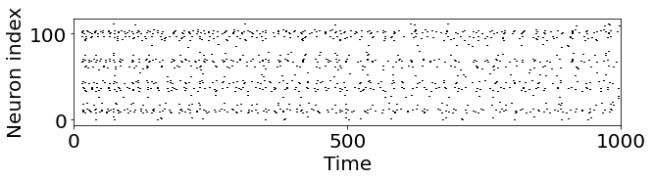
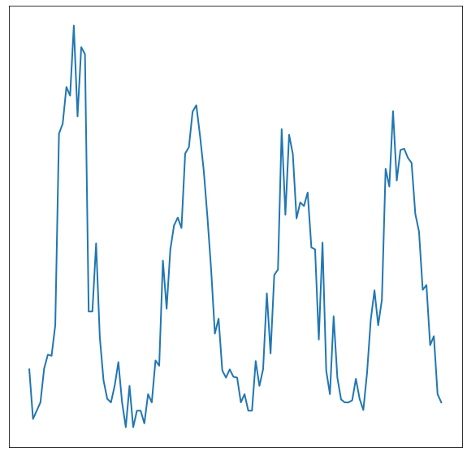
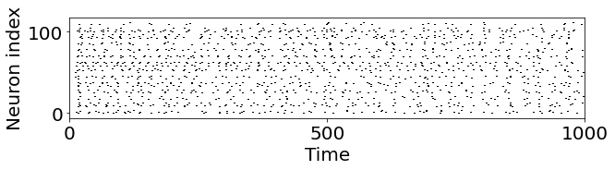
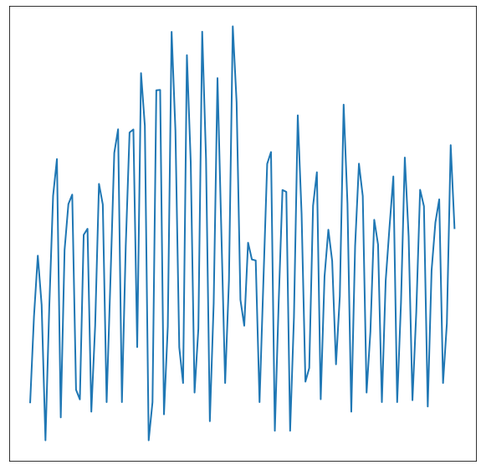
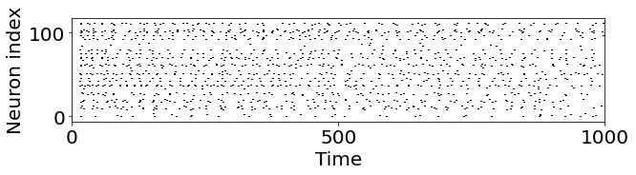
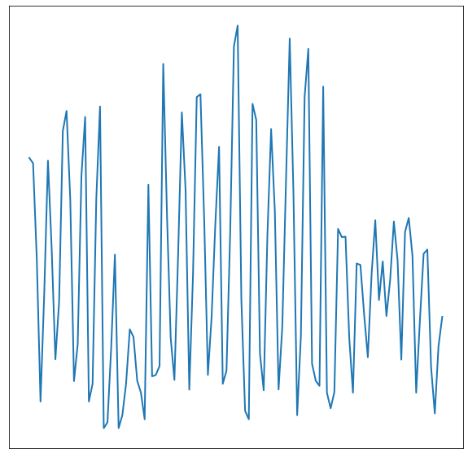
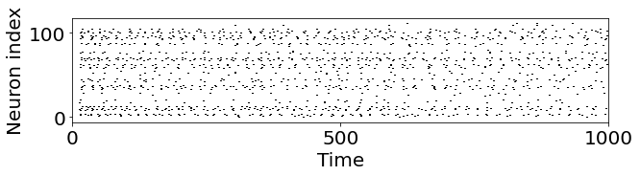
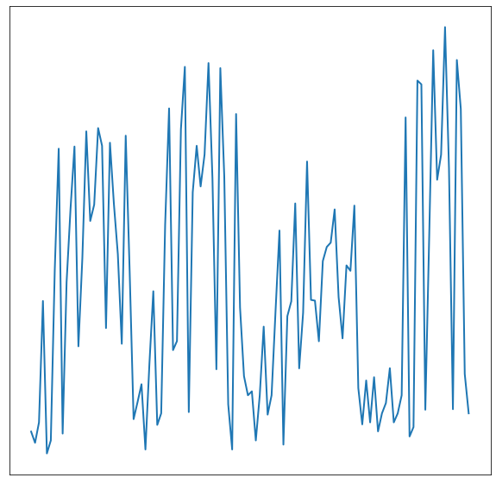
Result
Angle
각기 다른 orientation의 자극물을 통해 각도정보를 성공적으로 디코딩할 수 있는지 테스트함.
0°
90 °
135 °
45 °
0°
90 °
135 °
45 °
0°
90 °
135 °
45 °
0°
90 °
135 °
45 °

Slide 12
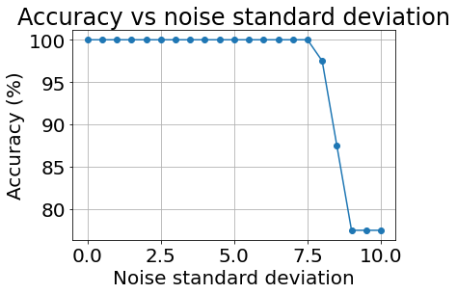
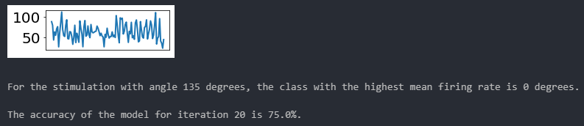
Result
Angle
각기 다른 orientation의 자극물을 통해 각도정보를 성공적으로 디코딩할 수 있는지 테스트함.
Biomimetic decoder
0°
0°
90 °
90 °
135 °
135 °
45 °
45 °
가장 큰 발화율을 갖는 functional neuronal group에 해당된다.
자극별로 Synaptic noise SD를 변화시켜 10번씩 반복 측정
(pA)
<Counterexample>

Slide 13


Result
Bar Stimulus Movement
각기 다른 orientation의 자극물을 통해 위치정보를 성공적으로 디코딩할 수 있는지 테스트함.
수평 막대 자극물 - 수직 이동의 경우, 수평 방향 필터의 발화율이 더 높았으며, 이를 통해 각기 다른 방향의 자극물을 구분할 수 있음.
Vertical moving stimulation
Horizontal moving stimulation
Pyramidal neurons firing pattern/ 2-D firing rate
X - filter
Pyramidal neurons firing pattern/ 2-D firing rate
X - filter
100
100
20
20
Neuron index
10
10
Neuron index
0
0
0
0
500
1000
0
0
500
1000
Time (ms)
Time (ms)
Y - filter
100
Y - filter
100
20
20
Neuron index
Neuron index
10
10
0
0
0
0
0
500
1000
0
500
1000
Time (ms)
Time (ms)

Slide 14
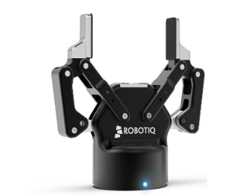
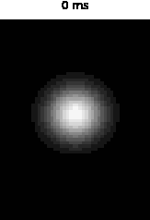

Result
RA – Slip object
일정 시간이 흐른 후 급격히 강하 (Slip)하는 자극물에 대한 움직임 검출을 수행하는지 테스트하였음
Slip dot 객체를 활용한 스파이킹 신경망(SNN) 연구를 통해, RA(빠르게 적응하는) 수용체가 SA(느리게 적응하는) 수용체보다 순간적으로 미끄러지는 자극에 더 민감하게 반응하는 것으로 확인됨.
Third layer activity (Pyramidal neurons)
Second layer activity (SA/ RA projection neurons)
Slip-dot stimulation
SA projection neurons firing pattern/ 2-D firing rate (Hz)
100
80
Neuron index
40
0
Slip
0
Pyramidal neurons firing pattern/ 2-D firing rate (Hz)
0
500
1000
100
Time (ms)
20
RA projection neurons firing pattern/ 2-D firing rate (Hz)
100
Neuron index
80
10
Neuron index
40
0
Slip
0
0
Slip
0
0
500
1000
0
500
1000
Time (ms)
Time (ms)
Notes:
이는 RA 수용체가 변화하는 자극에 빠르게 적응하고 반응하는 능력을 가지고 있는 반면, SA 수용체는 변화에 대해 더 느리게 적응하고 반응한다는 점에서 차이가 나타납니다. 따라서, 미끄러지는 자극과 같은 순간적인 변화에 대해 RA 수용체가 더 민감하게 반응할 수 있음을 알 수 있습니다.

Slide 15
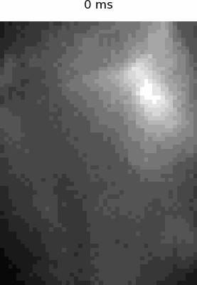
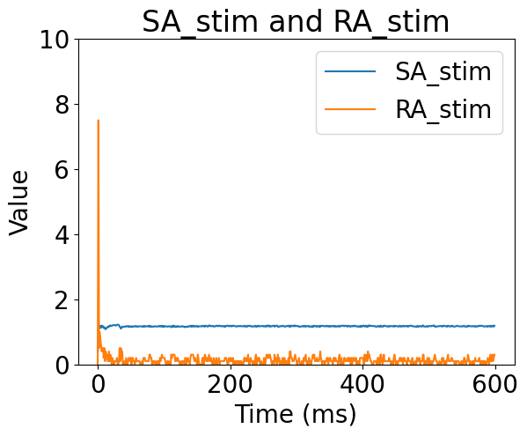
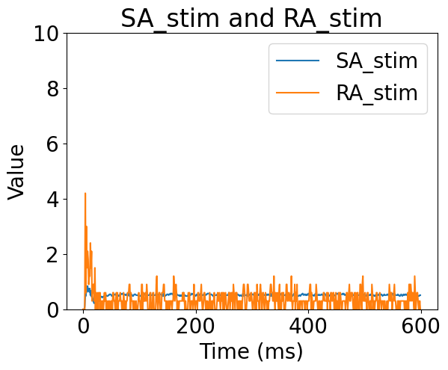
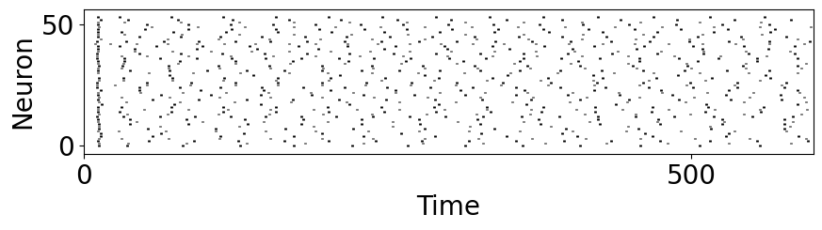
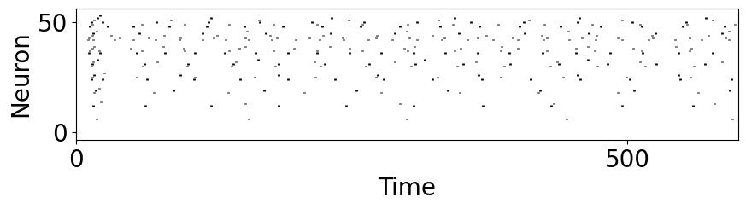
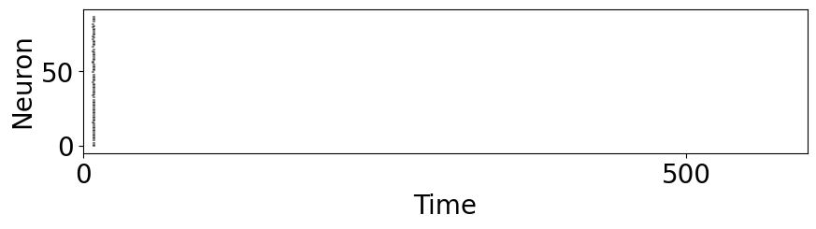
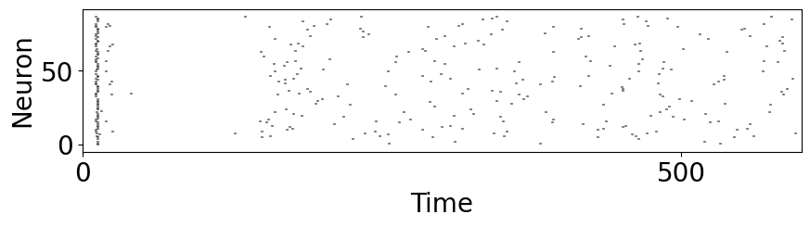
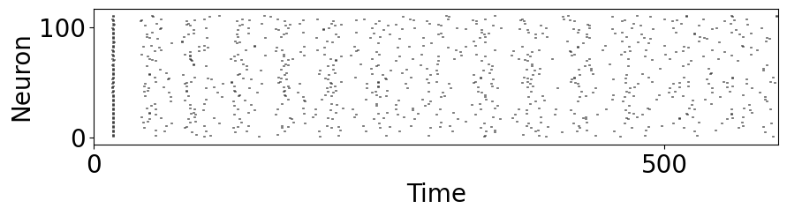
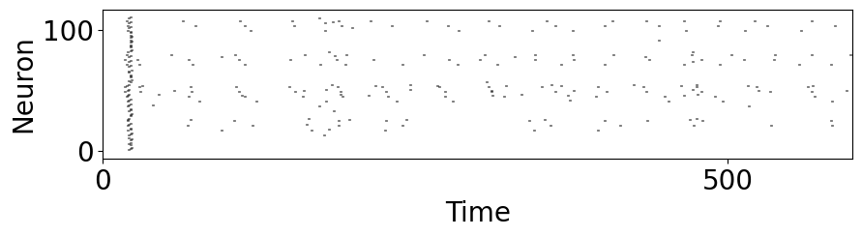
Result
GELSIGHT DIGIT Sensor
Baseline of sensor
Baseline correction
SA - 1
SA - 1
RA - 1
RA - 1
CN
CN
Notes:
이는 RA 수용체가 변화하는 자극에 빠르게 적응하고 반응하는 능력을 가지고 있는 반면, SA 수용체는 변화에 대해 더 느리게 적응하고 반응한다는 점에서 차이가 나타납니다. 따라서, 미끄러지는 자극과 같은 순간적인 변화에 대해 RA 수용체가 더 민감하게 반응할 수 있음을 알 수 있습니다.

Slide 16
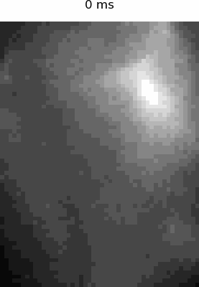
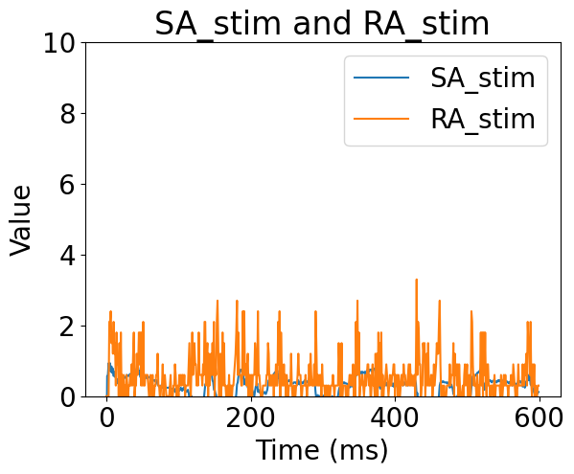
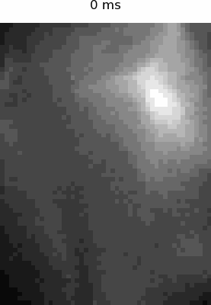







Result
GELSIGHT DIGIT Sensor
Pencil stimulation
Horizontal stimulation
SA - 1
SA - 1
RA - 1
RA - 1
CN
CN
Notes:
이는 RA 수용체가 변화하는 자극에 빠르게 적응하고 반응하는 능력을 가지고 있는 반면, SA 수용체는 변화에 대해 더 느리게 적응하고 반응한다는 점에서 차이가 나타납니다. 따라서, 미끄러지는 자극과 같은 순간적인 변화에 대해 RA 수용체가 더 민감하게 반응할 수 있음을 알 수 있습니다.

Slide 17


Discussion
Future study
1 | 1 | 1
10 | 10 | 10
20 | 20 | 20
1 | 1 | 1
20 | 20 | 20
50 | 50 | 50
Synaptic delay 최적화
Output layer로 부터 decoding된 tactile feature들을 어떻게 통합하여 로봇에 전달 할 것인가?
- Tactile feature layer 이 후 STDP를 이용한 Object clustering
- 물리적 특성을 정성적으로 파악할 수 있는 방법을 통해, 기존의 ANN과 비교.
3. Online SNN 환경에서의 reaction time

Slide 18
Attachment

Slide 19
Model overview – 05.15
Biomimetic Spiking Neural Network
Periphery
Mechanoreceptors & Afferents
Medulla
Cuneate Nucleus
Cortex
Somatosensory Cortex
Function 1
Excitatory synapse
Pyramidal neuron
Inhibitory synapse
Projection Neuron
c - Interneuron
SA - 1
Function 2
Afferent
Pyramidal neuron
Interneuron
Sensor signal
c - Interneuron
Projection Neuron
Afferent
Function n
Pyramidal neuron
RA - 1
Interneuron
c - Interneuron
Advanced Spiking Neural Network Architecture for Enhanced Tactile Sensing and Perception Capabilities

Slide 20













Model – 05.15
First order layer (Mechanoreceptors and SA-1/RA-1 afferent)
First order layer에서는 기계 수용체를 생성하고 Slowly adapting afferent type-1과 Fast adapting afferent type-1에 해당하는 수용장 구조를 가짐.
생리학적 근거를 기반으로 RA afferents 는 SA afferents에 비해 더 넓은 수용장 영역을 갖도록 설계됨.
Modeling of primary afferent (PA)
Mechanoreceptor Grid
3 mm
SA – 1
1.5 mm
9.5 mm
4 mm
RA – 1
8 mm
(Nima Salimi-Nezhad et al., 2020)
3 mm
Indentation
Glabrous skin
SA – 1 afferents
Simulated firing pattern
RA – 1 afferent
자극 On/Off
(Fatemeh Yavari et al., 2013)
지속적인 자극

Slide 21









Model overview – 05.15
Second order layer (Cuneate Nucleus)
쐐기핵의 신경회로적 기전 연구를 위해 흥분성 신경회로와 억제성 신경회로의 상호작용으로 측면 억제의 역할과 영향을 분석함.
측면 억제는 노이즈의 축적을 방지하고, 공간정보를 보존하는 역할을 수행함.
Modeling of Cuneate Nucleus
억제성 뉴런 비활성화
억제성 뉴런 활성화
Primary afferents
RA - 1
Interneurons
Projection neurons (without Inhibition)
Projection neurons (with Inhibition)
Noise reduction through lateral inhibition
Lateral inhibition
Primary afferents
SA - 1
Interneurons
(Adel Parivizi-Fard et al., 2021)

Slide 22











Model overview – 05.15
Third order layer (Primary somatosensory cortex)
Third order layer에서는 특화된 receptive field를 활용하여 기능적인 역할을 수행할 수 있는 출력층을 설계하였음.
Modeling of primary somatosensory cortex
PN
Periphery
Medulla
Cortex
Inhibitory region
Excitatory region
Synaptic weight
C-IN
방향성
Py
SA – 1 Mechanoreceptors
수용장
Tactile feature-specific synaptic connectivity
64 * 48
11 * 8
9 * 6
7 * 4
기계수용체 수용장
Pyramidal Neuron
방향성
Cortical Interneuron
RA – 1 Mechanoreceptors
수용장
64 * 48
13 * 10
11 * 8
7 * 4

Slide 23
Discussion – 05.15
Future study
1 | 1 | 1
10 | 10 | 10
20 | 20 | 20
1 | 1 | 1
20 | 20 | 20
50 | 50 | 50
Synaptic delay 최적화
Output layer로 부터 decoding된 tactile feature들을 어떻게 통합하여 로봇에 전달 할 것인가?
- Tactile feature layer 이 후 STDP를 이용한 Object clustering
- 러닝을 사용하여 특정한 Task를 수행 및 평가하기 적합하고, 기존의 ANN과 그 성능을 비교할 수 있어 모델 평가가 이루어질 수 있음
3. Online SNN 환경에서의 reaction time

Slide 24



Model overview – 03.27
Spiking Neural Network
Izhikevich Layer
Convolution Layer
Izhikevich Layer
Temporal kernel
Convolution Layer
1 | 1 | 1
3 | 3 | 3
5 | 5 | 5
Convolution filter
-5 | -5 | -5
0 | 0 | 0
5 | 5 | 5
I
SA - 1
Convolution filter
I
3 x 3 x 2 kernel
Step size: 1
Spatial kernel
Prewitt horizontal
10 x 10 kernel
Step size: 3
70 afferents
Downsampled sensor signal
1 | 1 | 1
3 | 3 | 3
5 | 5 | 5
Convolution filter
-5 | 0 | 5
-5 | 0 | 5
-5 | 0 | 5
I
60 Hz
64 * 48
3 x 3 x 2 kernel
Step size: 1
Prewitt vertical
Convolution filter
I
RA - 1
15 x 15 kernel
Step size: 3
54 afferents
1 | 1 | 1
3 | 3 | 3
5 | 5 | 5
Convolution filter
1 | 1 | 1
1 | 1 | 1
1 | 1 | 1
I
3 x 3 x 2 kernel
Step size: 1
Convolution filter
Advanced Spiking Neural Network Architecture for Enhanced Tactile Sensing and Perception Capabilities

Slide 25
Model overview – 04.12
Spiking Neural Network
First order layer:
Mechanoreceptors & Afferents
Second order layer:
Cuneate Nucleus
Third order layer:
Somatosensory Cortex
SA - 1
Projection Neuron
Afferent
Interneuron
Projection Neuron
sensor signal
Projection Neuron
Interneuron
Afferent
RA - 1
Interneuron
Excitatory synapse
Inhibitory synapse
Advanced Spiking Neural Network Architecture for Enhanced Tactile Sensing and Perception Capabilities

Slide 26
Izhikevich Layer
Convolution Layer
Izhikevich Layer
Temporal kernel
Convolution Layer
1 | 1 | 1
3 | 3 | 3
5 | 5 | 5
Convolution filter
-5 | -5 | -5
0 | 0 | 0
5 | 5 | 5
I
SA - 1
Convolution filter
I
3 x 3 x 2 kernel
Step size: 1
Spatial kernel
Prewitt vertical
10 x 10 kernel
Step size: 3
70 afferents
Downsampled sensor signal
1 | 1 | 1
3 | 3 | 3
5 | 5 | 5
Convolution filter
-5 | 0 | 5
-5 | 0 | 5
-5 | 0 | 5
I
60 Hz
64 * 48
3 x 3 x 2 kernel
Step size: 1
Prewitt horizontal
Convolution filter
I
RA - 1
15 x 15 kernel
Step size: 3
54 afferents
1 | 1 | 1
3 | 3 | 3
5 | 5 | 5
Convolution filter
1 | 1 | 1
1 | 1 | 1
1 | 1 | 1
I
3 x 3 x 2 kernel
Step size: 1
Convolution filter

Slide 27



Model overview
Spiking Neural Network
Synapse (The receptive field of a higher-order neuron)
Time kernel
Skin (Mechanoreceptor)
1 | 1 | 1
3 | 3 | 3
5 | 5 | 5
Receptive field
-5 | -5 | -5
0 | 0 | 0
5 | 5 | 5
I
SA - 1
Neuron (higher-order)
3 x 3 x 2 kernel
Step size: 1
Spatial kernel
Receptive field
I
Prewitt vertical
10 x 10 kernel
Step size: 3
70 afferents
Downsampled sensor signal
1 | 1 | 1
3 | 3 | 3
5 | 5 | 5
Receptive field
-5 | 0 | 5
-5 | 0 | 5
-5 | 0 | 5
I
60 Hz
64 * 48
3 x 3 x 2 kernel
Step size: 1
Prewitt horizontal
Receptive field
I
RA - 1
15 x 15 kernel
Step size: 3
54 afferents
1 | 1 | 1
3 | 3 | 3
5 | 5 | 5
Receptive field
1 | 1 | 1
1 | 1 | 1
1 | 1 | 1
I
3 x 3 x 2 kernel
Step size: 1
Convolution filter
Advanced Spiking Neural Network Architecture for Enhanced Tactile Sensing and Perception Capabilities

Slide 28


Method
Input current
spike count
Firing rate
Y - Pixel
X - Pixel
Input layer
Convolution layer
Izhikevich layer
(64 x 48)
(19 x 13)
(19 x 13)

Slide 29




Method
Input layer
Convolution layer
Izhikevich layer
(64 x 48)
(19 x 13)
(19 x 13)
Convolution filter
<CODE>
Input data (64 x 48 -> vector)
W (# of kernel x # of input layer neuron)
X (# of input layer neuron)
O (# of kernel)
x
=

Slide 30

Method
Input layer
Convolution layer
Izhikevich layer
(64 x 48)
(19 x 13)
(19 x 13)
Convolution filter
<CODE>
Input data (64 x 48 -> vector)
W (# of kernel x # of input layer neuron)
X (# of input layer neuron)
O (# of kernel)
x
=
=

Slide 31




Method
Input layer
Convolution layer
Izhikevich layer
(64 x 48)
(19 x 13)
(19 x 13)
Convolution filter
+
+
…
=
X (# of input layer neuron)
Filter 1
O (# of kernel)
W (# of kernel x # of input layer neuron)
Filter 2
x
=
Filter 3
…

Slide 32


Method
Izhikevich layer
Convolution layer
Izhikevich layer
(19 x 13)
Convolution filter

Slide 33


Method
Input layer
Convolution layer
Izhikevich layer
(19 x 13)
Convolution filter
<CODE>
Last layer spike train(# of buffer * (pixel_h * pixel_w))

Slide 34
Method
Input layer
Convolution layer
Izhikevich layer
(19 x 13)
Convolution filter
1 –D Spike
Temporal kernel
Vectorized 2-D spike
# of time buffer
0 | 1 | 0 | 0
1 | 1 | 0 | 0
1 | 1 | 1 | 1
0 | 0 | 0 | 0
1 | 0 | 0 | 1
1 | 1 | 1 | 1
1 | 1 | 1
3 | 3 | 3
5 | 5 | 5
# of time buffer
0 | 0 | 0 | 0
1 | 1 | 0 | 0
1 | 1 | 1 | 1
0 | 0 | 0 | 0
1 | 0 | 0 | 1
1 | 1 | 1 | 1
0 | 0 | 0 | 1
1 | 1 | 0 | 0
1 | 1 | 1 | 1
0 | 0 | 0 | 0
1 | 0 | 0 | 1
1 | 1 | 1 | 1
Padding
0 | 0 | 0 | 0
1 | 1 | 0 | 0
1 | 1 | 1 | 1
0 | 0 | 0 | 0
1 | 0 | 0 | 1
1 | 1 | 1 | 1
1 | 0 | 1 | 1
1 | 1 | 0 | 0
1 | 1 | 1 | 1
0 | 0 | 0 | 0
1 | 0 | 0 | 1
1 | 1 | 1 | 1
1 –D Temporal kernel
1 | 0 | 1 | 0
1 | 1 | 0 | 0
1 | 1 | 1 | 1
0 | 0 | 0 | 0
1 | 0 | 0 | 1
1 | 1 | 1 | 1
Vectorization
Vectorized 2-D Temporal kernel
# of kernel

Slide 35
Method
Input layer
Convolution layer
Izhikevich layer
(19 x 13)
Convolution filter
1 –D Spike
Torch.gather
1 | 1
2 | 2
3 | 3
1 | 1
2 | 2
3 | 3
1 | 1
2 | 2
3 | 3
# of time buffer
Delayed_spikes
W (# of kernel x # of input layer neuron)
1 | 2
1 –D Temporal kernel
1 | 3
2 | 5
1 | 4
1 | 2
1 | 3
2 | 5
1 | 4
# of kernel

Slide 36



Method
Input layer
Convolution layer
Izhikevich layer
(19 x 13)
Convolution filter
Prewitt vertical
Prewitt horizontal
Convolution filter

Slide 37
Summary
Progress update
시각적으로 spiking activity를 들여다 볼 수 있도록 결과 도출
Static stimuli에 대한 결과 도출
Inhibitory layer 분리
Synaptic delay 기반 object moving direction detection (Debugging with Errors) ~ 3.29
Key Findings
Firing rate plot을 통한 spiking activity 2-D visualization
Static stimuli에 대한 edge detection
Next step
SA & FA integration layer (new output layer) ~ Next week
Online application with tactile sensor ~ Mid-April
Meeting schedule
3.29 (차세대 AI team meeting)
First week of April (차세대 AI team meeting)
Third week of April (차세대 AI team meeting)

Slide 38




Result
Static edge stimuli
Input signal
SA
RA
Time domain
SA
RA

Slide 39




Result
Static edge stimuli
SA
RA
SA Prewitt horizontal
RA Prewitt horizontal
SA Prewitt vertical
RA Prewitt vertical

Slide 40


Result
Static edge stimuli
Input signal
SA
RA
Time domain
SA
RA

Slide 41




Result
Static edge stimuli
SA
RA
SA Prewitt horizontal
RA Prewitt horizontal
SA Prewitt vertical
RA Prewitt vertical

Slide 42





Result
Static edge stimuli
Izhikevich Layer
Convolution Layer
Izhikevich Layer
Temporal kernel
1 | 1 | 1
3 | 3 | 3
5 | 5 | 5
Convolution Layer
-5 | -5 | -5
0 | 0 | 0
5 | 5 | 5
I
Convolution filter
SA - 1
Convolution filter
I
3 x 3 x 2 kernel
Step size: 1
Spatial kernel
Prewitt horizontal
10 x 10 kernel
Step size: 3
70 afferents
Downsampled sensor signal
60 Hz
64 * 48
Convolution filter
I
RA - 1
15 x 15 kernel
Step size: 3
54 afferents
Input current
spike count
Firing rate
spike count
Firing rate

Slide 43





Result
Static edge stimuli
Izhikevich Layer
Convolution Layer
Izhikevich Layer
Temporal kernel
1 | 1 | 1
3 | 3 | 3
5 | 5 | 5
Convolution Layer
Convolution filter
-5 | 0 | 5
-5 | 0 | 5
-5 | 0 | 5
I
SA - 1
Convolution filter
I
3 x 3 x 2 kernel
Step size: 1
Spatial kernel
Prewitt vertical
10 x 10 kernel
Step size: 3
70 afferents
Downsampled sensor signal
60 Hz
64 * 48
Convolution filter
I
RA - 1
15 x 15 kernel
Step size: 3
54 afferents
Input current
spike count
Firing rate
spike count
Firing rate

Slide 44



Result
Static edge stimuli
Input signal
SA
RA
Time domain
SA
RA

Slide 45










Result
Static edge stimuli
Static edge stimulation
Spike count of first layer
Input current of first layer
Spike frequency of first layer
Spike count of horizontal second layer
Spike count of vertical second layer

Slide 46
Result
Static edge stimuli
Static edge stimulation
Spike count of first layer
Input current of first layer
Spike frequency of first layer
Spike count of horizontal second layer
Spike count of vertical second layer

Slide 47









Result
Moving Dot
Moving Dot Stim
Input current of first layer
Spike frequency of first layer

Slide 48












Method
Stimulation
Sensor Signal
/ 10
Down Sampling
60 Hz
640 * 480
60 Hz
64 * 48
Moving Dot Stim
Moving Edge Stim
Falling Stim
Time domain
Time domain
Time domain

Slide 49

Method
Spiking Neural Network
Robot arm: UR3
Gripper: Robotiq 2f-85
Tactile sensor: GelSight Digit
Sensing field [mm]: 19 x 16
Image resolution: 640 x 480
Image FPS: 60
5 | -2.5
5 | -2.5
5 | -2.5
5 | -2.5
5 | -2.5
SA - 1
Receptive field
Receptive field
5 x 2 kernel
Step size: 1
10 x 10 kernel
Step size: 6
70 afferents
Sensor Signal
/ 10
Down Sampling
Receptive field
5 | 5 | 5 | 5 | 5
-2.5 | -2.5 | -2.5 | -2.5 | -2.5
60 Hz
640 * 480
60 Hz
64 * 48
2 x 5 kernel
Step size: 1
Receptive field
5 | 5 | 5 | 5 | 5 | 5 | 5
5 | 5 | 5 | 5 | 5 | 5 | 5
5 | 5 | 5 | 5 | 5 | 5 | 5
5 | 5 | 5 | 5 | 5 | 5 | 5
5 | 5 | 5 | 5 | 5 | 5 | 5
5 | 5 | 5 | 5 | 5 | 5 | 5
5 | 5 | 5 | 5 | 5 | 5 | 5
RA - 1
15 x 15 kernel
Step size: 6
54 afferents
Receptive field
7 x 7 kernel
Step size: 1
Spiking Neural Network Architecture for Tactile Sensing and Perception

Slide 50
Method
Primary afferents
SA - 1
SA – 1 afferents
Receptive field
10 x 10 kernel
Step size: 6
70 afferents
Receptive field
RA - 1
15 x 15 kernel
Step size: 6
54 afferents
28 mechanoreceptors in each receptive field
Mechanoreceptor Grid
RA – 1 afferent

Slide 51


Method
Primary afferents
Python code
SA – 1 afferents
28 mechanoreceptors in each receptive field
RA – 1 afferent
Receptive_field.py
Main.ipynb

Slide 52


Method
Functional Layer
Python code
5 | -2.5
5 | -2.5
5 | -2.5
5 | -2.5
5 | -2.5
Receptive field
5 x 2 kernel
Step size: 1
Receptive field
5 | 5 | 5 | 5 | 5
-2.5 | -2.5 | -2.5 | -2.5 | -2.5
2 x 5 kernel
Step size: 1
5 | 5 | 5 | 5 | 5 | 5 | 5
5 | 5 | 5 | 5 | 5 | 5 | 5
5 | 5 | 5 | 5 | 5 | 5 | 5
5 | 5 | 5 | 5 | 5 | 5 | 5
5 | 5 | 5 | 5 | 5 | 5 | 5
5 | 5 | 5 | 5 | 5 | 5 | 5
5 | 5 | 5 | 5 | 5 | 5 | 5
Receptive_field.py
Receptive field
7 x 7 kernel
Step size: 1
Main.ipynb

Slide 53


Method
Update
Python code
Sensor Signal
Primary afferents
Functional layer
L2_SA
L1_SA
SA_receptive_input
SA_receptive_input_2
Stim[:,:]
RA_receptive_input_2
SNN.py
RA_receptive_input
L1_RA
L2_RA
Main.ipynb
Feedforward update

Slide 54











Result
Sustain pressure
SA-vertical
Pressure
SA
SA-horizontal
Time
SA-wide
RA
RA-vertical
Time domain
RA-horizontal
Simulation time = 0.40

Slide 55









Result
Moving Dot
SA-vertical
Moving Dot Stim
SA
SA-horizontal
SA-wide
RA
Time domain
RA-vertical
RA-horizontal
Simulation time = 0.40

Slide 56







Result
Moving edge 0 degree
SA-vertical
Moving Edge Stim
SA
SA-horizontal
RA
SA-wide
Time domain
RA-vertical
0 degree
RA-horizontal
Simulation time = 0.40

Slide 57







Result
Moving edge 90 degree
SA-vertical
Moving Edge Stim
SA
SA-horizontal
RA
SA-wide
Time domain
RA-vertical
90 degree
RA-horizontal
Simulation time = 0.40

Slide 58







Result
Falling Stim
SA-vertical
SA
Falling Stim
SA-horizontal
SA-wide
RA
RA-vertical
RA-horizontal
500ms
Simulation time = 0.40

Slide 59
Conclusion
The primary afferents layer is composed of SA and FA afferents with a specific density and number, and it is expected to have a down-sampling effect on the sensor signal. This is not a novel finding, as it has been previously studied.
The use of various functional kernels in our research has enabled the detection of pressure, slip, and edge detection, which is a novel contribution to the field.
Our Online-SNN model performs mathematical calculations in the current time zone, but there is potential for improvement through the use of a spike-buffer and introduction of a synaptic delay kernel, which could help to identify more diverse time domain features.
Currently, excitatory and inhibitory neurons are mixed in the kernel, but separating them into different layers is necessary for improved performance.
Overall, our research has contributed novel findings related to functional kernels for tactile perception and the potential for improvement of the Online-SNN model through the use of spike-buffer and synaptic delay kernel. However, further work is needed to separate excitatory and inhibitory neurons into different layers in the model.
Spatial kernel
Time kernel
Spatial kernel
5 | Delay = 1 ms | -2.5 | 5 ms
5 | 5 ms | -2.5 | 1 ms
5 | 1 ms | -2.5 | 5 ms
5 | 5 ms | -2.5 | 1 ms
5 | 1 ms | -2.5 | 5 ms
5 | -2.5
5 | -2.5
5 | -2.5
5 | -2.5
5 | -2.5

Slide 60

Spiking Neural Network
Uses of touch sensing in manipulation
(Howe, 1990)

Slide 61


Spiking Neural Network
Dynamic data and time domain
Static domain
*
Time domain
*
Temporal kernels

Slide 62

Spiking Neural Network
Simulation Data
2-D wave with 1-axis
Simulation & Data acquisition
2-D wave with 2-axis

Slide 63

directions of skin indentation
Spiking Neural Network
Dynamic tactile features
Spatial frequency
Shape
constant pressure
+
Direction of skin indentation

Slide 64

Spiking Neural Network
The typical adaptation of the four afferent types
Rapidly Adapting type
Meissner corpuscles RA 1: close to skin surface 1 to 300 Hz (5 to 50 Hz)
static force and low-frequency vibration object movement exhibit greater sensitivity but poorer spatial resolution
Pacinian corpuscles
RA 2: deeper layer of the skin
5 to 800 Hz (30 to 500 Hz)
temporal structure of high-frequency vibratory stimuli
Slowly Adapting type
Merkel cells
SA 1: close to skin surface
Up to 100 Hz (0.3 to 5 Hz)
High spatial resolution. corners, edges and curvatures of objects
Ruffini ending
SA 2: nail bed and rarely found in deeper layer of the dermis
Stretching during dynamic and static phase of skin indentations
proprioception

Slide 65
Spiking Neural Network
The typical adaptation of the four afferent types
Rapidly Adapting type
Meissner corpuscles RA 1: close to skin surface 1 to 300 Hz (5 to 50 Hz)
static force and low-frequency vibration object movement exhibit greater sensitivity but poorer spatial resolution
Pacinian corpuscles
RA 2: deeper layer of the skin
5 to 800 Hz (30 to 500 Hz)
temporal structure of high-frequency vibratory stimuli
Slowly Adapting type
Merkel cells
SA 1: close to skin surface
Up to 100 Hz (0.3 to 5 Hz)
High spatial resolution. corners, edges and curvatures of objects
Ruffini ending
SA 2: nail bed and rarely found in deeper layer of the dermis
Stretching during dynamic and static phase of skin indentations
proprioception
Spatial frequency
Shape
constant pressure
Direction of skin indentation

Slide 66
Spiking Neural Network
The typical adaptation of the four afferent types
Rapidly Adapting type
Meissner corpuscles RA 1: close to skin surface 1 to 300 Hz (5 to 50 Hz)
static force and low-frequency vibration object movement exhibit greater sensitivity but poorer spatial resolution
Pacinian corpuscles
RA 2: deeper layer of the skin
5 to 800 Hz (30 to 500 Hz)
temporal structure of high-frequency vibratory stimuli
Slowly Adapting type
Merkel cells
SA 1: close to skin surface
Up to 100 Hz (0.3 to 5 Hz)
High spatial resolution. corners, edges and curvatures of objects
Ruffini ending
SA 2: nail bed and rarely found in deeper layer of the dermis
Stretching during dynamic and static phase of skin indentations
proprioception
Spatial frequency
Contact Timing
Softness
Shape
Texture
Grip control Vibration
Edge detection
constant pressure
Direction of skin indentation

Slide 67


Spiking Neural Network
Shape
Convolutional spiking neural network
Layer segmentation (finger by finger)
Deeper network
Parameter optimization
Long-term spike frequency adaptation
Convolution kernel
(Receptive field)
Weight
Finger 1
learning
Spatial kernel
1
1 x 1
*10
-0.5
1
-0.5
1 x 3
*5
Finger 2
-0.5
1
0
1 x 2
*5
21-channel
tactile sensor
0
1
-0.5
1 x 2

Slide 68

Spiking Neural Network
Edge orentation
기계수용체 모사 기반 인공 촉각 신경계 모델
(Parvizi-Fard et al. 2021)

Slide 69

Spiking Neural Network
Edge orentation
기계수용체 모사 기반 인공 촉각 신경계 모델
(Parvizi-Fard et al. 2021)

Slide 70

Spiking Neural Network
Edge orentation
기계수용체 모사 기반 인공 촉각 신경계 모델
(Parvizi-Fard et al. 2021)

Slide 71

Spiking Neural Network
Direction
Spike carrying direction
Up
Down
Spatio-temporal kernel
Slow
Direction of Stimulation
Synaptic delay
Medium
Fast
Up
Down
Direction of Stimulation

Slide 72



Future study
Tactile sensor & simulatro
DIGIT Tactile Sensor
TACTO simulator
A Fast, Flexible and Open-source Simulator for High-Resolution Vision-based Tactile Sensors

